Slide 1
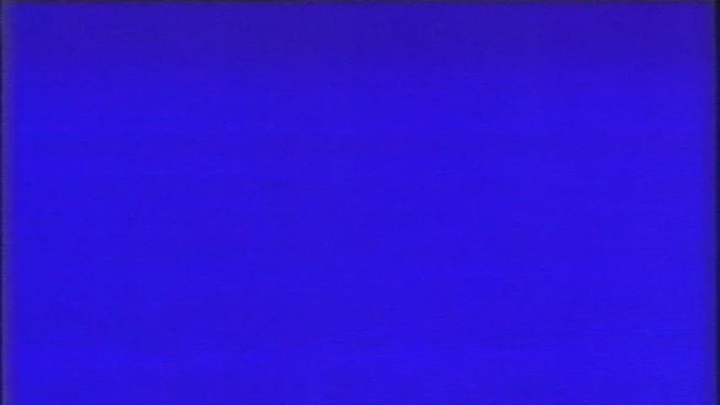

Play
Web User Interface Design
Website Project
No Signal Media
News Article Website
Made by:
Pavel Dobias
Eliska Vrzalova
Jake Kelly
Slide 1/18

Slide 2
Play
Website Project
Introduction
We have chosen to create a website centered around movies, for our love and passion for cinema.
From relevant News to more opinion-based Reviews, we want to give everything a movie geek needs to know.
Slide 2/18

Slide 3




Play
Website Project
Team Members
Low-fidelity concept and design
News, News Article and Reviews
Site-map
Homepage, Movie Calendar, Feedback Form and navigation bar
User flow
Article Page, Article
Information Page, About No Signal
Slide 3/18

Slide 4
Play
Website Project
Research & User Insights
Similar websites: Filmtopia.net, besthorrorscenes.net, letterboxd.com
Key findings: aesthetics, layout, feedback option, review and news features
User personas: Movie fans mainly, all age groups, users with multiple goals (movie recommendations, what to watch next, updates, news)
Feedback and changes: fonts, colors, layouts, hierarchy
Slide 4/18

Slide 5
Play
Website Project
Goals & Value Proposition
Core objectives: to provide movie fans or anyone else with- reviews, articles, news, updates, upcoming movies
Communicate and spread this passion through great user experience
What makes us unique?
Covering many movie related areas, feedback option, design ideas
Slide 5/18

Slide 6

Play
Website Project
Preliminary Designs & Feedback
The design comes from No Signal screen seen on older TVs, with color pallete and the theme coming from it, using the old TV screen as a logo and each color representing different part of the website.
Slide 6/18

Slide 7


Play
Website Project
Preliminary Designs & Feedback
While implementing the design in development we have made multiple changes, refining the overall look and usability of the site.
Final design
First Design
Slide 7/18

Slide 8
Play
Website Project
Development & Responsiveness - Eliska
Homepage and navigation bar created first – pieces of code were used across other pages for consistency
Movie Calendar was not originally part of our design
Layout of the pages ended up being very different from our wireframes
Responsiveness for mobile and tablet screens
Changing grid layouts
Tablet is similar to desktop version
Burger menu for mobile version
Slide 8/18

Slide 9
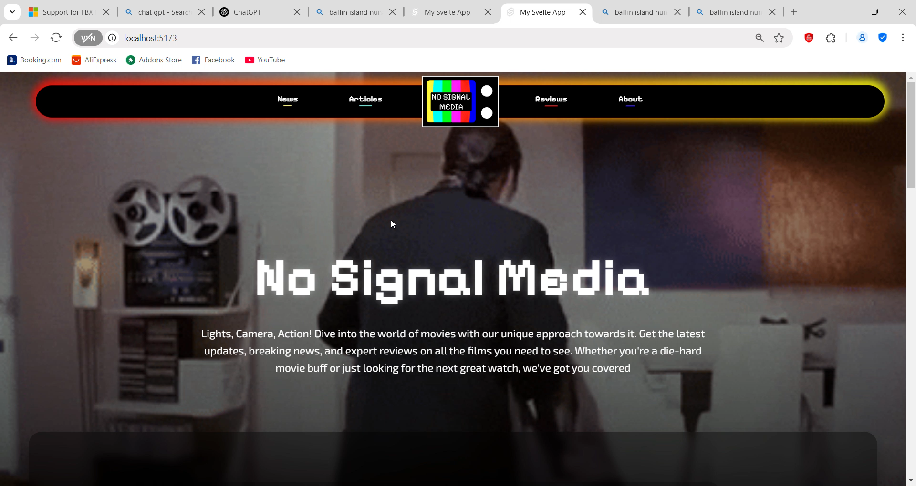
Homepage
Play

Slide 10
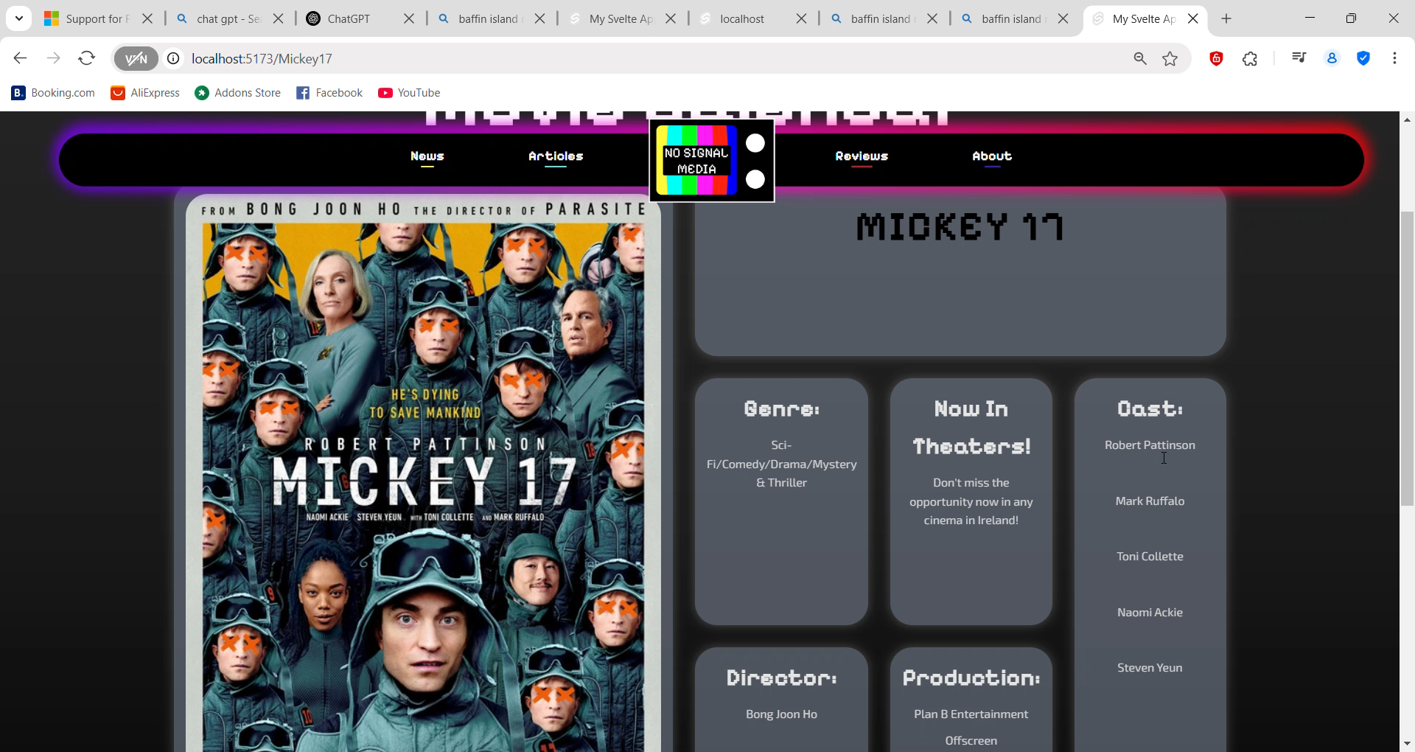
Movie Calendar
Play

Slide 11
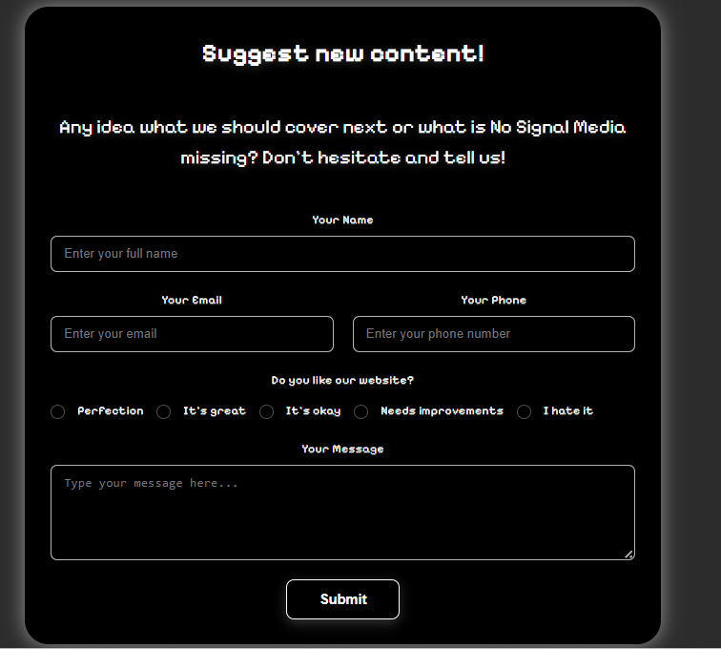
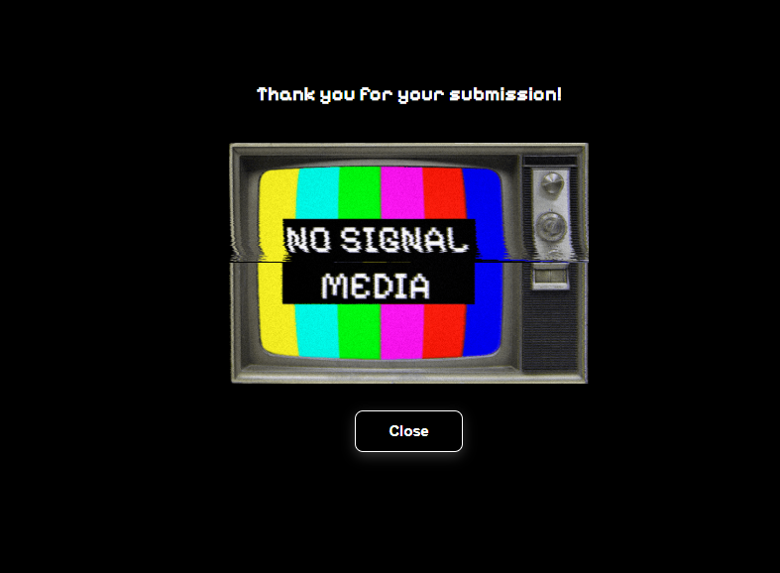
Suggest new content
Play

Slide 12
Website Project
Development & Responsiveness - Pavel
Play
Implementing the components for Reviews and News to fill in the pages went through multiple iterations:
First as a raw html, using just headings and paragraphs
Second using classes and starting with grids
Third using a simple js script to fill in the elements
Grid layout was simple to make responsive, adding breakpoints and rearranging the grid layout to fit smaller screens
Slide 12/18

Slide 13
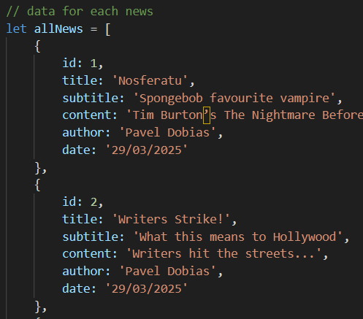
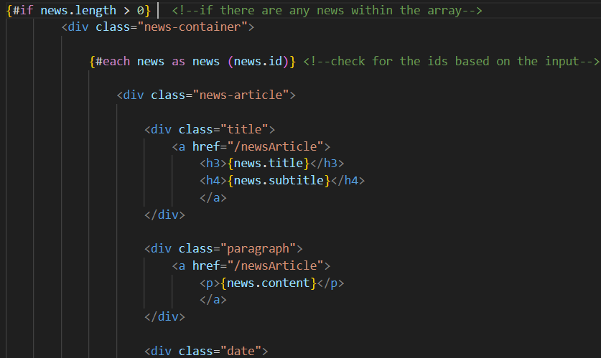
Website Project
Development & Responsiveness - Pavel
Play
script
html
Slide 13/18

Slide 14
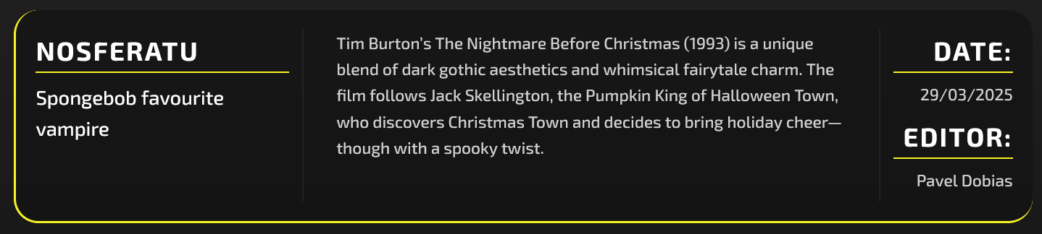
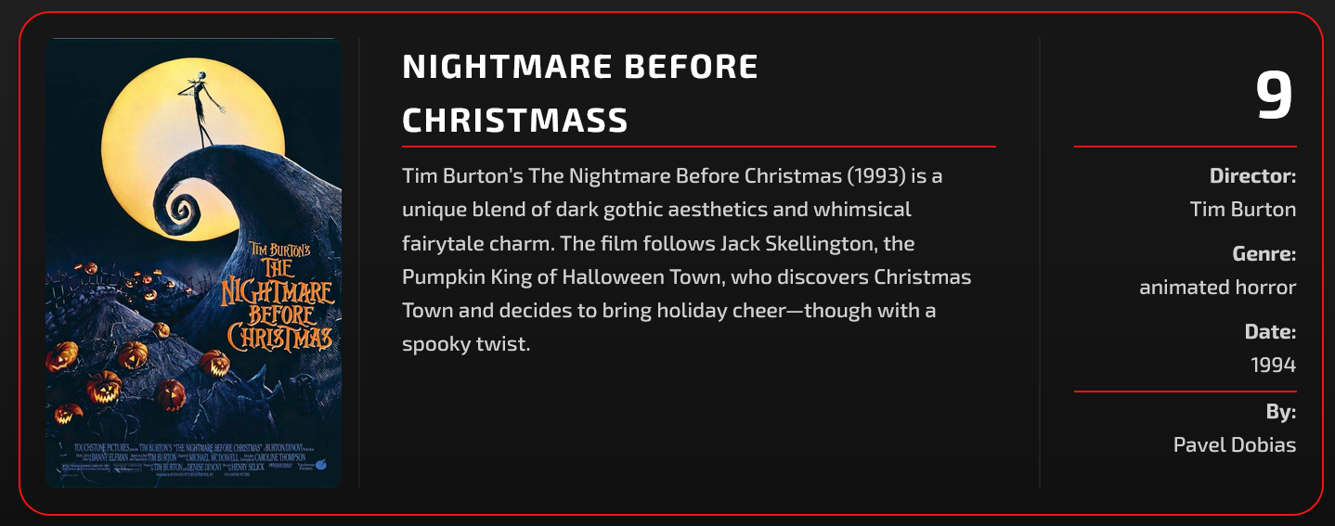
Website Project
Development & Responsiveness - Pavel
Play
By adding some styles, I ended up with this:
News
Adding hover effects to emphasize news importance
Reviews
Reviews
Highlighting the image and title when hovered.
More information about the movie director, genre and more.
Slide 14/18

Slide 15


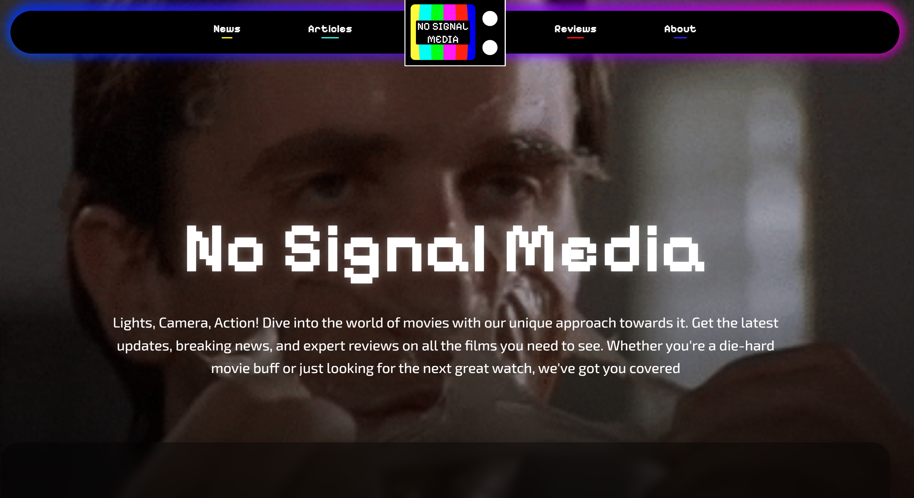
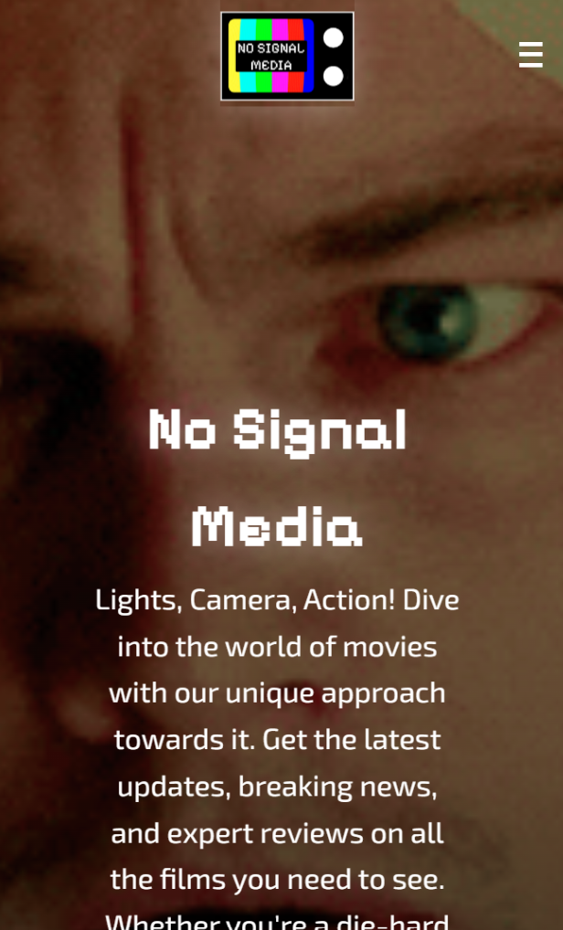
Play
Website Project
Testing, Optimisation & Deployment
Through-out the development, we used testing to make our web-pages legible on both Desktop and Mobile.
Using Chrome’s Developer Tools proved to be a plus.
Testing revealed visual bugs.
Acts as a milestone / checkpoint.
Slide 15/18

Slide 16

Play
Website Project
Testing, Optimisation & Deployment
Components helped when it came to our Development , Workflow & Optimization, having a well-structured library & properly named
Files proved efficient too.
Although we haven't reached the Deployment stage of our website yet, everything is coming up promising!
Slide 16/18

Slide 17
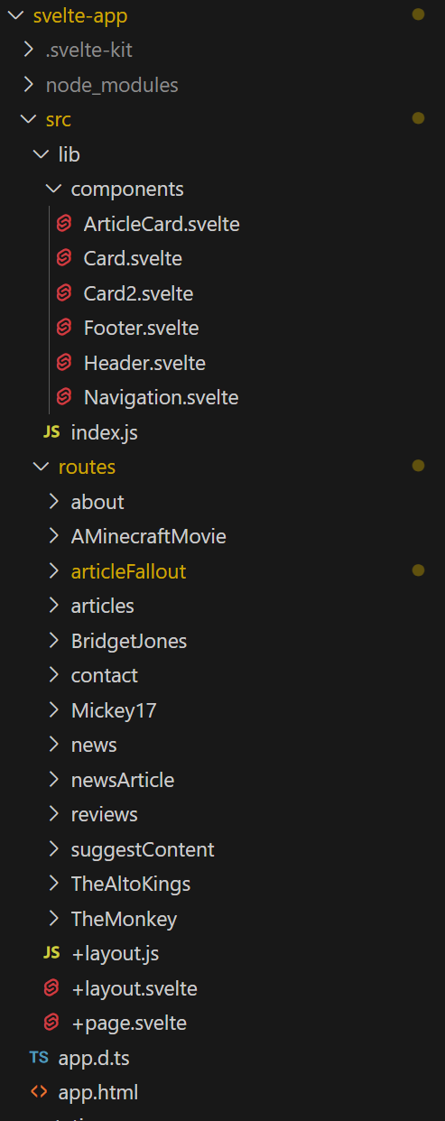
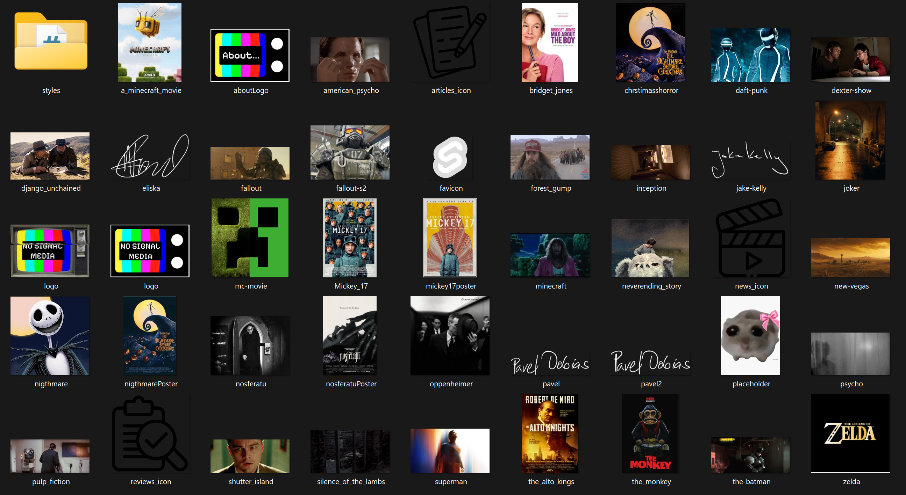
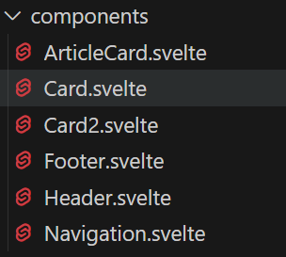
Website Project
Testing, Optimisation & Deployment
Play
Slide 17/18

Slide 18
Play
Website Project
Reflections & Future Steps
Pavel: “Working with Svelte seemed daunting at first, but after familiarizing myself with the basics I soon learned how powerful tool Svelte is. Now it is hard for me to imagine creating website without it.”
Eliska: “I have learned so many things, my favorite part is how CSS has unlimited options. The hardest part for me was homepage and responsive code.”
Jake: “Working with the tools provided, proved to be an enlightening experience. Putting the skills taught to use was both frustrating, and more importantly, a rewarding experience, I'm hoping to apply them more going forward.”
Slide 18/18

Slide 19
Play
Thank you for listening!

